Slide 1

Software Engineering
Introduction to Software Engineering
Reuse Focused Software Development Approaches – CBSE
Department of Computer Science and Engineering
Acknowledgement: Authors of the prescribed textbooks and materials sourced online.

Slide 2

Reuse Focused Software Development Approaches – CBSE
List of Contents
CBSE - Component Based Software Engineering
Software Component
Component Development Stages
Component Model
Product Lines
Product Lifecycle Reuse Principles
Product Line Engineering Framework

Slide 3
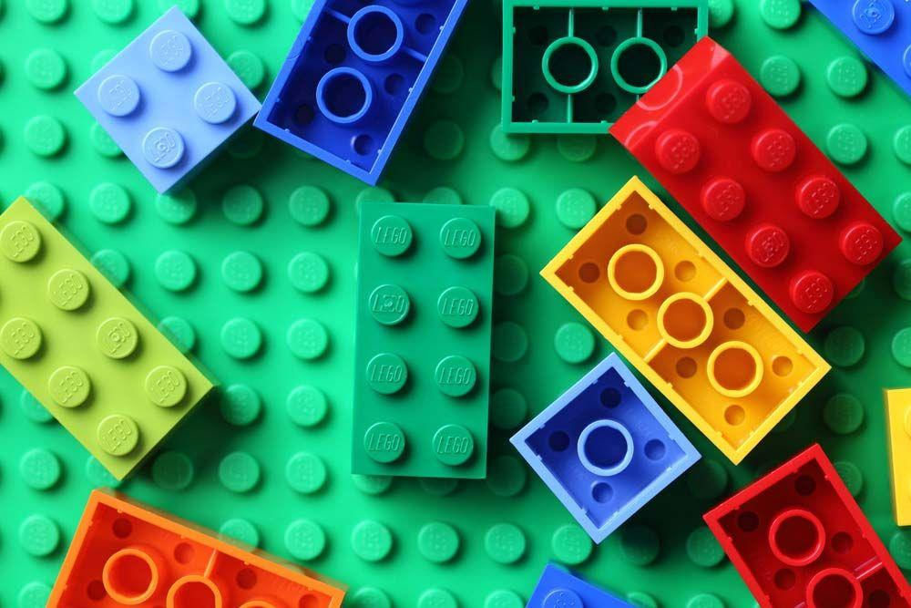
Introduction - Lego Blocks
We all know what Lego is. It is a set of building blocks in different sizes and colors.
They can be combined together to form different shapes.
Lego blocks are generic and easily composable.
But, Lego blocks can only be combined with other Lego blocks. they cannot be combined with any other blocks like Meccano!
Can you identify the common themes across Lego blocks?
Reuse
Quickly assemble models
Build complex models from simple blocks

Slide 4
CBSE – Component Based Software Engineering
What is CBSE?
Component-based software Engineering approach is a reuse based approach to define,
implement or select of-the shelf components and integrate/compose loosely coupled
independent components into systems
Why do we need CBSE?
Increase in complexity of systems
Reuse rather than re-implement and shorten development time
Advantages of CBSE Disadvantages of CBSE
Black box usage of components
Trusting components
Reduced development time
Component certification
Increases quality
Emergent property prediction
Increases productivity
Requirement trade off

Slide 5
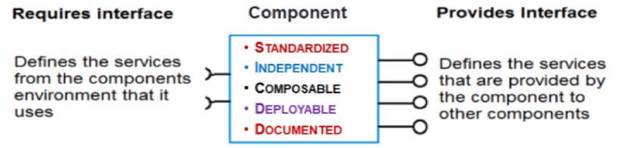
Essentials of CBSE
Independent components that are completely specified by the public interfaces
Component standards that facilitate the integration of components
Middleware that provides software support for component integration
Development process that is geared up to CBSE
Software Component
What is a software component?
Independent executable entity that can be made up of one or more executable objects.
It has explicit dependencies through “required” interfaces and “provides”.

Slide 6
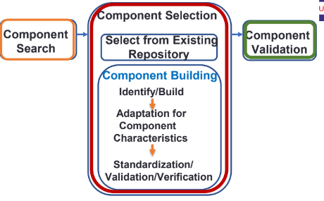
Software Component
The component interface is published and all interactions are through the published interface.
What does a software component do?
Implements a functionality without regard to where the component is executing or its programming language
IDENTIFYING A COMPONENT
Search for component
Select component
Adapters or “glue” to reconcile different component interfaces
Compose component from existing ones (if readily not available)
Validate the component

Slide 7
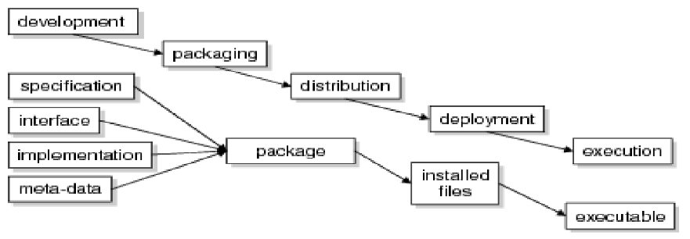
Component Development Stages
Different forms of component representation:
During development – UML
When packaging – .zip
In the execution stage – blocks of code and data

Slide 8
Component model
Component model – defines the types of building block, which can be composed with other components to create a software system
Elements of component model
Interfaces
Usage
Deployment
Defines how component can interact and also defines operation names,
parameters and exceptions
In order for components to be distributed and accessed remotely, they need to have
a globally unique name or handle associated with them
Specification of how components should be
packaged for deployment as independent, executable entities

Slide 9
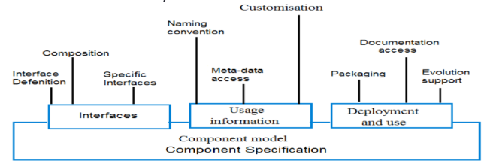
Component model

Slide 10
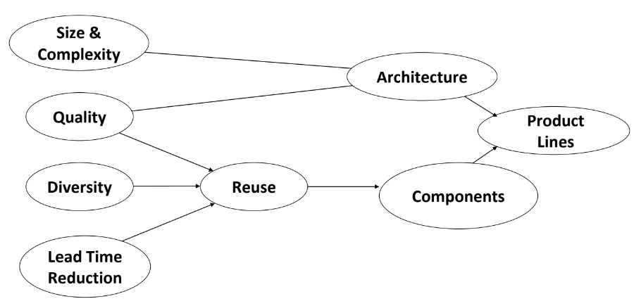
Product Lines

Slide 11
Software Product Lines
A product line represents a family of manufactured products
A product line architecture explicitly captures the commonality and variability
of a product line components and their compositions
Software product lines refers to engineering techniques for creating a portfolio
of similar software systems from a shared set of software assets
Software Product Line Engineering makes it possible to
Create software for different products
Use variability to customize the software to each different product

Slide 12
Key Drivers for effective product lifecycle re-use
Software product lines enhance reuse through predictive software reuse (rather than opportunistic reuse)
Software artifacts are created when reuse is predicted in one or more products in a well defined product line
These artifacts could be built as components which are reusable or could be looked at as design patterns which could be built using some fine grained components for a particular
solution

Slide 13
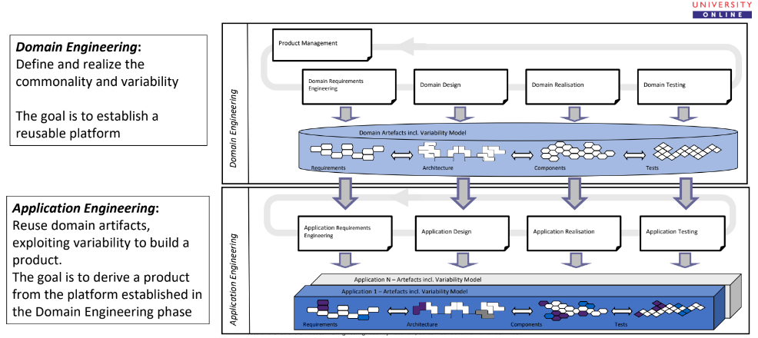
Product Line Engineering Framework

Slide 14
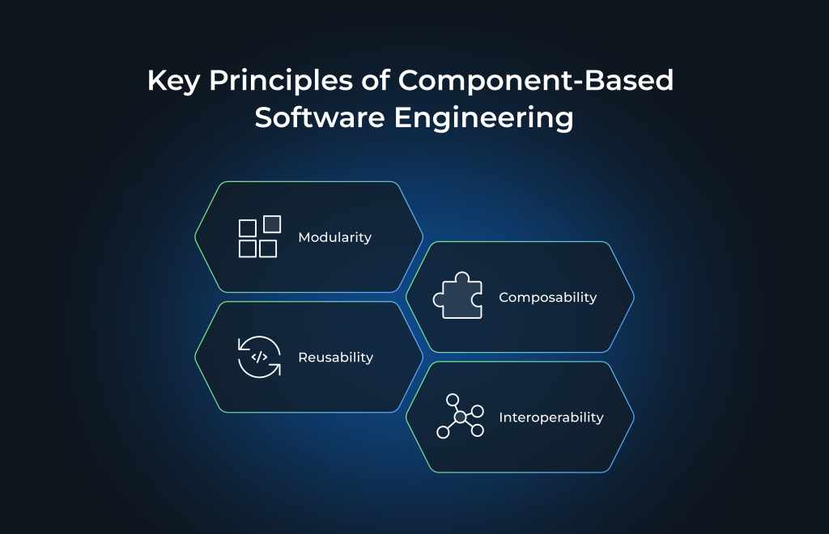
CBSE
Link : https://wesoftyou.com/outsourcing/component-based-software-engineering-explained/

Slide 15
THANK YOU

